Slide 1
Innovating Cities:
‘100 Climate Neutral Cities by 2030 by and for the Citizens’
“The human centred city: Opportunities for the Citizens through R&I”
Maria Yeroyanni
Senior Expert Innovating Cities
DG Research & Innovation
Unit D2 « Future Urban and Mobility Systems »
marie.yeroyanni@ec.europa.eu

Slide 2
FP6,FP7, H2020 Evidence knowledge base
Substantial evidence knowledge obtained from EU Research Framework Programmes over the last 30 years (FP5, FP6, FP7 and H2020)
Overall, Horizon 2020 funded 3.1 billion EUR for calls 2014-2020 dealing with Smart and Sustainable cities.

Slide 3
30 years of EU funded Urban development EUR ~1 billion
Horizon 2020 EUR ~3,1 billion for 612 projects
R&I Actions EUR ~12 million, ~30 participants
200 cities : hubs of Innovation& Living Labs
marie.yeroyanni@ec.Europa.eu

Slide 4
EU H2020 calls on Cities (2016-2019)
Climate and Water Resilient cities
Inclusive Urban Regeneration
New business and governance models
Circular and regenerative cities (GA started in June 2019)
Citizens in EU cities successfully replicate and upscale best practices Systemic and cross-sectorial solutions that combine technological, digital, social and nature-based innovation;
SC5-13-2019: Nature-based solutions for restoration and rehabilitation of urban ecosystems
SC5-14-2019: Visionary and integrated solutions to improve well-being and health in cities ( Call under evaluation-results in October 2019)
SC5-23-2019: Multi-stakeholder dialogue platform
SC5-20-2019: Transforming historic urban areas and/or cultural landscapes into hubs of entrepreneurship and social and cultural integration
SC5-2019: NBS to improve air quality in cities

Slide 5
LC-CLA-11-2020: Innovative nature-based solutions for
carbon neutral cities and improved air quality
Practical Information:
Focus area: Building a low-carbon, climate resilience future
Innovation Action (IA)
Evaluation Process: Two-stage
Planned opening date: 12 November 2019
Deadlines: First Stage: 13 February 2020
Second Stage: 3 September 2020
EU contribution in the range of EUR 30 million (~10 million per project)

Slide 6
  H2020 Projects tackling Circular Economy
Projects on:
Systemic services for circular economy
Circular value and supply chain
Circular and regenerative cities
Cultural heritage reuse in a circular economy approach
Water and waste management
Urban metabolism
Total: 30 projects
* Data on projects managed by EASME B.2 for cities-related projects under SC5 of H2020 funded between 2014-2019
Notes:
Also Climate Services and impact projects: heath stress and health

Slide 7

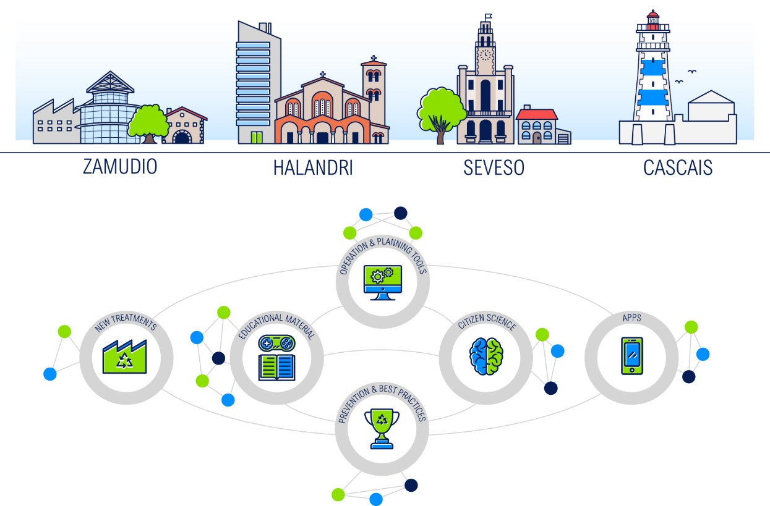
Coordinator: FUNDACION DEUSTO (ES)
Beneficiaries: 24 (ES,IT, PT, GR, DE, DK)
EU contribution: 8,818,556 € €
Duration: 42 months (Started: June 2016)
The main objective is demonstrate the value of integrating and validating 20 eco-innovative solutions that cover all the waste value chain.
The benefits of these solutions will be enhanced by a holistic waste data management methodology, and will be demonstrated in 4 complementary urban areas in Europe
http://waste4think.eu/
Notes:
The project is relevant to the following priorities
1: Reduction of plastics
7: Evaluating the circularity effect of shared economies in cities
The main objective of this project is to move forward into circular economy motto, demonstrating the value of integrating and validating a set of 20 eco-innovative solutions that cover all the waste value chain.
The eco-innovative solutions include technological and non-technological tools such as IT tools to support the daily operation and long-term planning, Apps for citizens empowerment and engagement, Educational materials, Mechanisms to boost behavioral changes based on economic instruments and social actions, and Decentralized solutions for valorization and reuse of high value resources.
These solutions will be will be demonstrated in 4 complementary urban areas in Europe in Spain, Greece, Italy and Portugal.

Slide 8


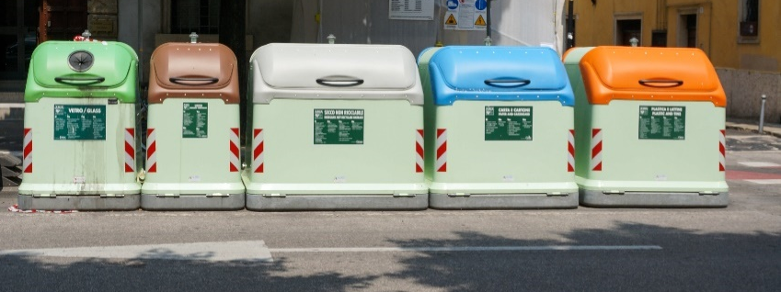
Coordinator: KOBENHAVNS KOMMUNE (DK)
Beneficiaries: 24 (DK, IT, PT, DE)
EU contribution: 9,724,969 €
Duration: 48 months (Started: September 2016)
The four cities involved in the project, Copenhagen, Hamburg, Lisbon and Genoa, will engage enterprises, citizens and academia in 16 participatory value chain based partnerships to create and develop eco-innovative solutions.
Demos
Copenhagen: mixed plastic waste
Genoa: wood waste
Hamburg: WEEE
Lisbon: food
Thematic : Reduction of plastics, bio-based materials, fueling CE
http://www.ce-force.eu/
Notes:
The FORCE project aims to minimise the leakage of materials from the linear economy and work towards a circular economy.
The four cities involved in the project, Copenhagen, Hamburg, Lisbon and Genoa, will engage enterprises, citizens and academia in 16 participatory value chain based partnerships to create and develop eco-innovative solutions.
Each city will establish a lead partnership for one of the four materials: plastic waste, strategic metals from electronic and electric equipment, surplus food and biowaste, and wood waste. Each city will also establish three local partnerships for the other materials.
The project is relevant to the following priorities:

Slide 9
Coordinator: KWB KOMPENTENTZZENTRUM WASSER BERLIN GEMEINNUTZIGE GMBH (DE)
Beneficiaries: 24 (DE, DK, FR,IL,BG,IT,BE, ES, NO, NL)
EU contribution: € 4.999.557,15
Duration: 42 months (Start: 1ST June 2019)
Develop 18 advanced Digital Solutions (DS) regarding groundwater management, sewer maintenance and operation, WW treatment and reuse and urban bathing water management
Demonstrate the DS in 5 European urban and peri-urban areas: Berlin, Milan, Copenhagen, Paris and Sofia
Contribute to the protection of human health, the increase of performance and ROI of water infrastructures and the involvement of citizens
Thematic: Water-Waste-City nexus
Notes:
The project is relevant to the following priority
6 Integrate agricultural supply function in the Water - Waste – City Nexus in a virtual controlled but real cycle
digital-water.city’s (DWC) main goal is to boost the integrated management of waters systems in five major European urban and peri-urban areas, Berlin, Milan, Copenhagen, Paris and Sofia, by leveraging the potential of data and smart digital technologies. DWC will create linkages between the digital and the physical worlds by developing and demonstrating 18 advanced digital solutions to address current and future water-related challenges; namely the protection of human health, the increase of performance and return on investment of water infrastructures and the involvement of citizens in urban water management. Areas of application of DWC digital solutions range from groundwater management, sewer maintenance and operation, wastewater treatment and reuse to urban bathing water management. DWC combines cutting-edge digital technologies such as augmented reality, open source software, cloud computing, real-time sensors, artificial intelligence, predictive analytics and decision support systems. DWC integrates the development of digital solutions in a dedicated guiding protocol to cover the existing gaps regarding ICT governance, interoperability, ontology and cybersecurity. Ultimately, DWC will provide an interoperable free flow of information among stakeholders and across the water value chain. DWC will generate the necessary conditions for co-creation and open innovation by the establishment of Community of Practices aiming at integrating stakeholder knowledge, ensuring the transferability of the digital solutions in other European or international contexts, supporting knowledge transfer beyond DWC and creating durable binding between European cities. The large scale assessment and communication of the benefits provided by the digital solutions in five major cities will serve as lighthouse, raising the awareness of European cities for a necessary digital transformation, and opening new market opportunities for DWC partners and European providers of digital solution

Slide 10

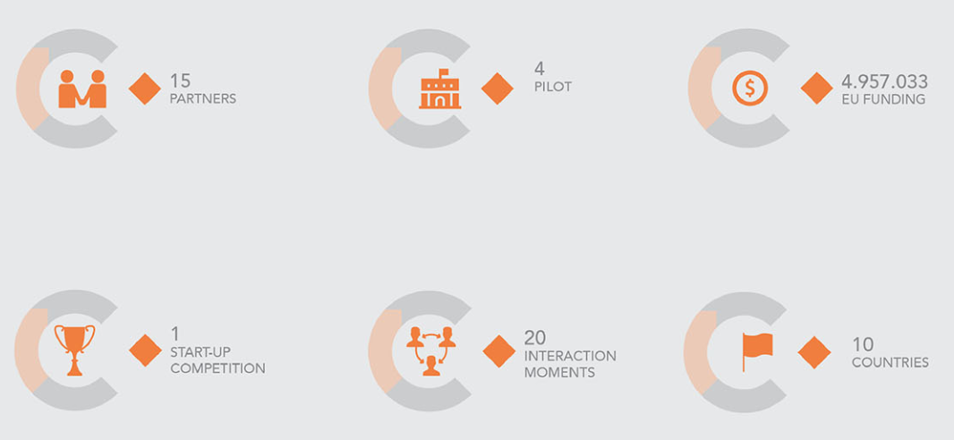
Projects on adaptive reuse of heritage
CLIC - Circular models Leveraging Investments in Cultural heritage adaptive reuse
CLIC applies the circular economy principles to cultural heritage adaptive reuse
Reuse of cultural heritage is seen as a mean to circularize the flows of raw-materials, energy, cultural capital as well as social capital
Thematic: Circular cities
Notes:
The CLIC project applies the circular economy principles to cultural heritage adaptive reuse for achieving environmentally, socially, culturally and economically sustainable urban/territorial development. Adaptive reuse of cultural heritage is seen as a mean to circularize the flows of raw-materials, energy, cultural capital as well as social capital. The circular paradigm is assumed in the project not only for the economic growth but also for promoting human development.
Pilots: Rijeka, Salerno, Vastra Gotaland, Amsterdam
21 November, CLIC activities:
workshop of CLIC Task Force: an open discussion on how to link Cultural Heritage and Circular Economy models. Invited participants include EC, EU funded projects on CH, European Investment Bank representatives, experts on financing and business models.
Transdisciplinary Laboratory on “Circular governance between theory and practice”. The Laboratory will discuss circular governance at all levels, including: the urban commons transitions, how to govern the circular metabolism, how to include the cultural sector in a circular economy perspective.

Slide 11

Coordinator: Institut Bruxellois pour la Gestion de l'Environnement (BE)
Beneficiaries: 15 (BE, NL, DE, UK, SE, PT, BA)
EU contribution: € 8,858,766
Duration: 48 months (Started: September 2015)
Design circular value chains to prevent C&D waste and reduce virgin material consumption
  Material passports
  Reversible building design
  New business models
  transform buildings to deliver new functions
  disassemble building components or material feedstock
  6 pilots
http://www.bamb2020.eu/
Notes:
The project is relevant to the following priority
2 Circular Cities Demolition waste
The aims of BAMB (Buildings as Material Banks) are the prevention of construction and demolition waste, the reduction of virgin resource consumption and the development towards a circular economy through industrial symbiosis, addressing the challenges mentioned in the Work Programme on Climate action, environment, resource efficiency and raw materials. The focus of the project is on building construction and process industries (from architects to raw material suppliers). The BAMB-project implements the principles of the waste hierarchy: the prevention of waste, its reuse and recycling. Key is to improve the value of materials used in buildings for recovery. This is achieved by developing and integrating two complementary value adding frameworks, (1) materials passports and (2) reversible building design. These frameworks will be able to change conventional (cradle-to-grave) building design, so that buildings can be transformed to new functions (extending their life span) or disassembled to building components or material feedstock that can be upcycled in new constructions (using materials passports). This way, continuous loops of materials are created while large amounts of waste will be prevented. Activities from research to market introduction are planned. Fundamental knowledge gaps should be bridged in order to introduce both frameworks on the market. Advanced ICT tools and management models will enable market uptake and the organization of circular value chains in building and process industries. New business models for (circular) value chains will be developed and tested on selected materials. The inclusion of strategic partners along the value chains in an industrial board will maximize market replicability potential, while several (mostly privately funded) building pilots will demonstrate the potential of the new techniques. Awareness will be raised to facilitate the transition towards circularity by policy reform and changing consumer behaviour.

Slide 12

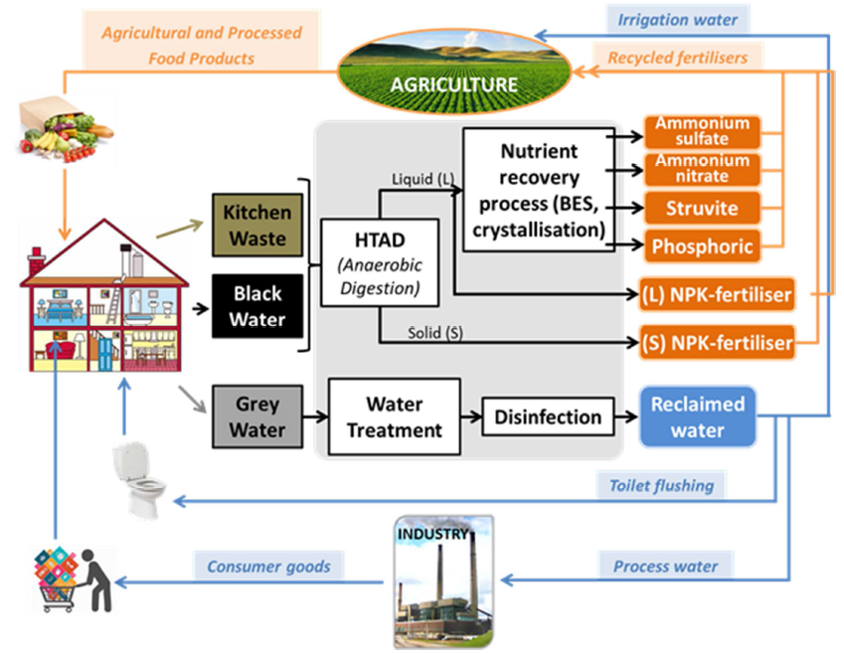
Recovery and utilisation of nutrients 4 low impact fertiliser.
Instrument: IA
Total Cost: € 8523735,00
EC Contribution: € 6239340,65
Duration: 4 years (2017-2021)
Project Coordinator:
AQUALIA (ES)
Notes:
The project is relevant to the following priorities
5: Sustainable ways to fuel the circular Economy
6: Integrate agricultural supply function in the Water - Waste – City Nexus in a virtual controlled but real cycle

Slide 13
Projects on circular and regenerative cities and building materials
REFLOW- constRuctive mEtabolic processes For materiaL flOWs in urban and peri-urban environments across Europe
Circuit- Circular Construction In Regenerative Cities
CINDERELA - New Circular Economy Business Model for More Sustainable Urban Construction
aaa
Pilots:

Slide 14

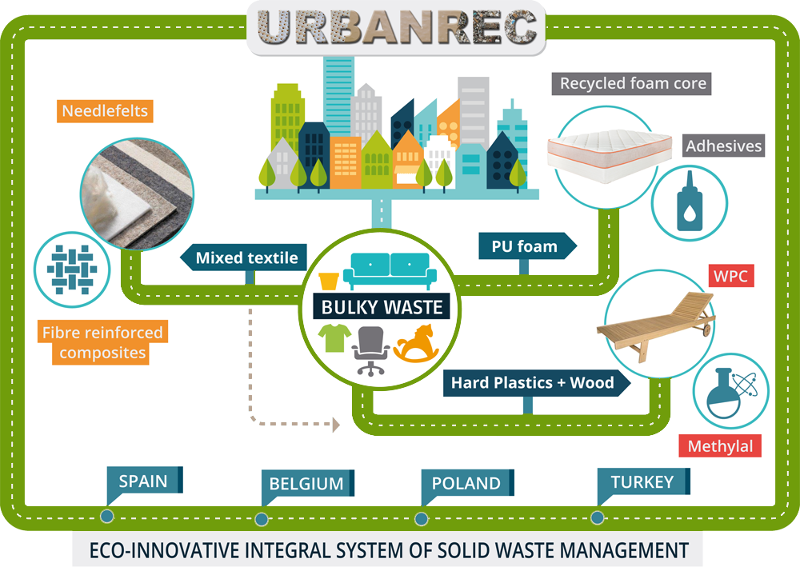
Coordinator: AIMPLAS (ES)
Beneficiaries: 21 (ES, BE, FR, DE, PL, PT, TR)
EU contribution: 8.618.970 €
Duration: 42 months (Started: June 2016)
Objectives
- develop and implement a bulky waste management system
- enhance prevention, improve logistics, obtain high added value recycled products, e.g. adhesives, foams, new hard plastics, textiles, chemicals and fuels.
Methods
Demonstration in 4 complementary urban areas (Belgium, Spain, Poland and Turkey)
http://www.urbanrec-project.eu/
Notes:
The project is relevant to the following priorities
5: Sustainable ways to fuel the circular Economy
7: Evaluating the circularity effect of shared economies in cities
URBANREC is an demonstration project that is addressing bulky waste. It aims at developing and implementing an eco-innovative integral bulky waste management system. The project objectives are to enhance prevention, improve logistics and allow new waste treatments as to obtain high added value recycled products, such as adhesives, foams, new hard plastics, textiles, chemicals and fuels.
URBANREC is demonstrating the effectiveness of the bulky management system in different EU regions (Northern, Mediterranean, Eastern and South-Eastern areas represented by Belgium, Spain, Poland and Turkey), with advanced techniques & new valorisation routes.
The project will finish at the end of 2019.
At the moment, the project achieved the separation of the different materials coming from bulky waste (wood and foam particles, jute fibres, polyamide fibres, etc.). These are being used in the development of the new valorisation routes to obtain final products (foams, hard plastics, etc.); thus contributing to a more Circular Economy.
URBANREC is expected to result in a potential valorisation of 82% of all European bulky waste (11.5 Million tons) landfilled, with an economic positive net profit of 225.6 €/ton.

Slide 15




Scaling up Innovation from local to…. global
Act
Local
and go global
“internationalisation, interoperability, replicability and more”
How to scale-up solutions in European cities and beyond,
to share the best practice experiences from past/ongoing projects, what are the key elements to make the projects successful.
EU R&I Networking Events:
ENoLL Open Days
Thessaloniki, 3-5 Sept 2019
DG R&I and EASME workshop
WORLD URBAN FORUM
Abu Dhabi, 8–13 February 2020 (networking session to be confirmed)
Notes:
Often we say….Think global, Act Local
This time we change this saying in do act local AND go Global with your best practice and your innovative solution
Networking events
Workshop co-organised by DG R&I, EASME in the frame of ENoLL Open Days
Networking session in the World Urban Forum co-organized by ENoLL, DG R&I and EASME

Slide 16
High-Level Expert Group Report on Innovating Cities (i)
Assist the Commission in formulating a R&I Policy Framework for Cities of the Future (e.g. feedback to Cities Mission);
Foster a systemic and cross-sectorial ‘urban ecosystem’ framework to guide investments in EU R&I actions on Innovating Cities in Horizon Europe;
.

Slide 17
High-Level Expert Group Report on Innovating Cities (ii)
HLEG launched on 12 June 2018;
The report promotes a systemic and cross-sectorial approach and goes beyond sectorial silos;
It addresses inter-linked urban challenges and nexus approaches related to mobility, energy, climate change, water, waste, resource efficiency, pollution, health, well-being and social inclusion, circular economy, natural resources;
Ensures alignment with the EU STRIA for mobility, SET Plan, COP21 Paris Agreement, IPCC 1.5 Global Warming report, Global Covenant Mayors Agenda “Innovate4Cities”, Urban Agenda for the EU, UN Habitat new Urban Agenda, JPI Urban Europe Strategic Agenda 2.0,Action Plan on Circular Economy, ECTP Horizon Europe Position Paper, etc.;

Slide 18
High-Level Expert Group Report on Innovating Cities (iii)
HLEG report will go online in December 2019;
It has been presented and validated during the European R&I Days on 24, 25 September (Cities Mission, Europe’s Clean Energy and City as Innovation Labs), and received a very positive feedback;
It promotes innovative urban design and planning, new governance, business and financial models across scales and foster, multi-stakeholder and participatory city-making processes and citizens’ engagement and empowerment in decision making;
9 High level experts covering multiple fields+2 observers
Chair: Charles Landry (Creative Cities)
Rapporteur: Riccardo Crescenzi (Economist, ERC)

Slide 19
Chapters of HLEG REPORT INNOVATING CITIES to be delivered 20 July (iv)
Setting the Scene
People
Place (Place based R&I dealing with energy efficiency, mobility, resilient and sustainable construction)
Prosperity (Economy)
Cross-cutting issues:
Governance
Measurements, impact evaluation
What success looks like
Separate volume: PUBLIC SUMMARY (4pages)

Slide 20
The Human Centred City: Aligned with seven agreed global agendas
  the UN SDGs & especially SDG 11
  the Paris Agreement on Climate Change
  the Habitat III New Urban Agenda
  the Urban Agenda for the EU
  the Sendai Framework for Disaster Risk Reduction 2015-2030
  the World Urban Forum meetings consensus
  The Global Solutions Summit linked to the G20

Slide 21
The Human Centred City: Rights & Responsibilities is:
  A city for citizens
  Citizens are city makers
  Citizens are shapers, makers co-creators of evolving city
  This is the ‘right to the city’
  This is not an entitlement - > active citizenship
  This is the ‘co-responsibility’ for addressing the big issues

Slide 22
Managing the transition: To overcome the systemic crisis
  Addressing the risk nexus
  Reassessing the economic order
  Operating with planetary boundaries
  Guiding the digitizing age
  Being inclusive, safe, resilient & sustainable

Slide 23
Urban Infrastructures: Context & key issues
Cities are metabolisms: They marshal, consume, process, import, export flows of resources - materials, goods, energy
Responsible for 2/3 of energy consumption & 70% CO2 emission
Sectors with main impact: Built environment, transportation, waste.

Slide 24
Critical issue 2: Circularity & sharing R&I actions
The key: Cradle to cradle business models
End the ‘end of life cycle’: reuse & recycle
New materials recyclable by design
Adaptive reuse, use smarts, bioclimatic design
Develop eco-friendly planning & design logic
Rethink all food cycles & food packaging
Imaginative waste & sewage systems

Slide 25
KEY MESSAGES & RECOMMENDATIONS
These highlights will contribute to the first 100 days of President-elect van der Leyen. More specifically, they will support the Climate Action and Green Deal Initiative: they aim to deliver an ambitious research, innovation and investment agenda notably for clean energy and mobility, zero-carbon circular cities, natural resources, climate resilience, and social innovation;
2030 innovative cities will operate as climate neutral and smart, citizen-centric, sustainable, inclusive, resilient and safe systems. The aim is to enhance the cities innovation capacity to address global urban challenges with a holistic view.

Slide 26
CHAPTER « PEOPLE »
It highlights the importance of making the most of the diversity and social inclusion, creating a city open for all, engaging and empowering citizens not just as residents but as actors of ‘Climate-neutral and Smart Cities’.
Key R&I recommendations:
-To address issues (e.g. social exclusion, inequalities and spatial segregation) by promoting cultural diversity, enhancing collective experience, building social bonding and achieving an inclusive city with services accessible to all.
-To understand the bonds, identify the drivers of well-being and lifestyles, social integration and cohesive communities and assess the impact of innovative zones of encounter as places of social cohesion, intercultural exchange between all age groups.

Slide 27
CHAPTER « PLACE »
The ‘place’ dimension advocates for innovative and circular urban planning and place-making to address key challenges (e.g. climate change, water and food insecurity, circular economy, energy and mobility issues, resource shortages) within planetary boundaries. This human centred urban planning and design is based on new business models.
Key R&I recommendations
-To promote (through integrated and innovative urban planning and design), high-performance built environments, liveable and inclusive cities that drive the circular economy agenda and unlock environmental and socioeconomic benefits, and give a direction towards sustainable economic growth, quality of life and social cohesion.

Slide 28
CHAPTER « PLACE »
-To improve the resilience to climate change, limit the global warming to 1.5 and achieve climate neutral cities. Decarbonisation needs to happen in the areas of energy, mobility, industry, agriculture and the built environment. The recommendations are zero positive city neighbourhoods, energy efficiency, clean energy, urban regeneration, adaptive reuse, quality place making (by recovering abandoned city areas).

Slide 29
CHAPTER ‘PROSPERITY’
The ‘prosperity’ dimension focuses on how the economy influences sustainable urban development and generates public value, with innovative solutions to build prosperous and resilient local economies in cities. It underlines the importance for cities to be part of global networks of capital, skills, knowledge and trade (of goods and services) and it calls for models able to finance public services and urban policies.
Key R&I recommendations
-To promote innovative urban ecosystems and inclusive, diverse, creative, cultural cities based on a new innovative approach to prosperity (e.g. generate innovation, jobs, equal distribution of opportunities for all citizens).
-To promote globally connected cities taking into account socio-economic conditions, technological capabilities, innovation potential, absorptive capacity and high-quality governance.

Slide 30
CHAPTER ‘RESILIENCE’
The ’resilience’ dimension requires looking into the city as a system of systems, understanding what is the essence of the city and the major risks it faces (climate change, cyber dependency, energy efficiency, water and food, infrastructure resilience, social conflicts, economic unrest and public health risks) and their interdependency.
Key R&I recommendations
-To advance urban resilience, focusing on the understanding of the institutional and social capacity of cities and citizens to design and implement robust plans and respond to potential risk shocks.
-To futureproof and enhance the performance of the most valuable city systems to address major risks (e.g. climate change, cyber dependency…) and reach targets set out by international agreements (such as Paris COP 21…).

Slide 31
Cross-Cutting Chapter ‘Governance’ & Measurement of impact
-To define urban governance: understanding complexities and the way cities are governed.
-To explore how innovative governance of tomorrow’s cities, relying on citizens’ engagement, will lead to a sustainable management of urban resources (eg public spaces, housing, resources…).
-There is a need to create measurement tools to assess cities performance.
-To promote education, training and culture of measurement and evaluation through the active participation of citizens (as generators, validators and users of their own city-level data).

Slide 32
Cities Event 21 March
(Policy recommendations +PPTs)
https://ec.europa.eu/research/environment/index.cfm?pg=events&eventcode=00E50670-BD47-1111-D5C967361D6887E9

Slide 33
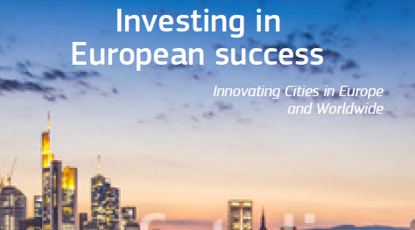
EU R&I Urban Booklet on EU funded project success stories
Investing in European Success: Innovating Cities in Europe and worldwide (available on-line)

Slide 34
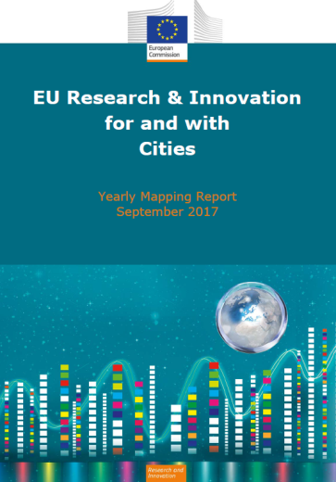
Yearly mapping of all Commission urban activities and initiatives under update process for 2019
EU Research and Innovation for and with Cities
Facts & Figures on H2020, FP7, FP6 and FP5
Annex with detailed project overview of H2020, FP7, FP6 and FP5

Slide 35
Innovating Cities Outreach
Innovating Cities web page (http://www.test.ec.europa.eu/research/environment/index.cfm?pg=future_cities
Commission TOPIC PAGE
  https://ec.europa.eu/info/events/cities
YEARLY MAPPING REPORT
https://publications.europa.eu/s/fGbs
executive one pager summary of this report:
http://europa.eu/!NU39Mx

Slide 36
  Horizon Europe

Slide 37


R&I Missions are…
Portfolios of actions across disciplines
intended to achieve a bold, inspirational and measurable goal within a set timeframe
with impact for society and policy making as well as relevance for a significant part of the European population and wide range of European citizens.
2021

Slide 38

Cities Mission (1)
‘Mission' means a portfolio of excellence-based and impact-driven R&I actions across disciplines and sectors, intended to:
achieve, within a set timeframe, a measurable goal that could not be achieved through individual actions;
have impact on society and policy-making through; science and technology, and
be relevant for a significant part of the European population and a wide range of European citizens;
Credits: https://www.un.org/sustainabledevelopment/sustainable-development-goals/
Notes:
Investing in research and innovation is investing in Europe’s future. It helps us to compete globally and preserve our unique social model and European way of life.
R&I improves the daily lives of millions of people here in Europe and around the world, helping to solve some of our biggest societal and generational challenges.
The Horizon Europe proposal significantly contributes to achieve the Commission's priorities and the global policy priorities.
This includes foremost the Sustainable Development Goals as well as the climate objectives in line with the Union's commitment to implement the Paris Agreement.
Regarding the latter the contribution expected from this programme is increased to 35% to reach the overall target of 25% of the Union expenditure.

Slide 39
Cities Mission (2)
using 00 as sources for design and implementation;
clear research and innovation content and EU-added value;
contributes to reaching Union priorities and commitments and Horizon Europe programme objectives;
covers areas of common European relevance;
is inclusive, broad engagement of various types of stakeholders from public and private sectors, including citizens and end-users;
will deliver R&I results that could benefit all Member States;
scientific, technological, societal, economic, environmental policy relevance and impact;
Credits: https://www.un.org/sustainabledevelopment/sustainable-development-goals/
Notes:
Investing in research and innovation is investing in Europe’s future. It helps us to compete globally and preserve our unique social model and European way of life.
R&I improves the daily lives of millions of people here in Europe and around the world, helping to solve some of our biggest societal and generational challenges.
The Horizon Europe proposal significantly contributes to achieve the Commission's priorities and the global policy priorities.
This includes foremost the Sustainable Development Goals as well as the climate objectives in line with the Union's commitment to implement the Paris Agreement.
Regarding the latter the contribution expected from this programme is increased to 35% to reach the overall target of 25% of the Union expenditure.

Slide 40
Cities Mission (3)
clear targeted, measurable objectives and clear budget frame;
have the necessary scope, scale and mobilization of the resources and leverage of additional public and private funds required to deliver the mission outcome;
stimulate activity across disciplines (including Social Sciences and Humanities) and encompassing activities from a broad range of TRLs, including lower TRLs;
open to multiple, diverse solutions considering societal needs and benefits
benefit from synergies with other Union & National programmes;
Credits: https://www.un.org/sustainabledevelopment/sustainable-development-goals/
Notes:
Investing in research and innovation is investing in Europe’s future. It helps us to compete globally and preserve our unique social model and European way of life.
R&I improves the daily lives of millions of people here in Europe and around the world, helping to solve some of our biggest societal and generational challenges.
The Horizon Europe proposal significantly contributes to achieve the Commission's priorities and the global policy priorities.
This includes foremost the Sustainable Development Goals as well as the climate objectives in line with the Union's commitment to implement the Paris Agreement.
Regarding the latter the contribution expected from this programme is increased to 35% to reach the overall target of 25% of the Union expenditure.

Slide 41





Adaptation to climate change, including societal transformation
Healthy oceans, seas, coastal and inland waters
5 Mission areas
Cancer
Climate-neutral and smart cities
Soil health and food

Slide 42
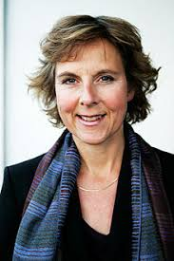
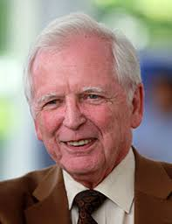
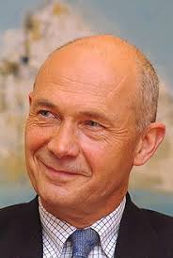
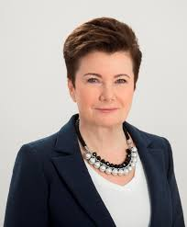
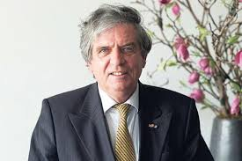
  Chairs of the Mission Boards
Adaptation to Climate Change including Societal Transformation:
Ms Connie Hedegaard
Cancer:
Prof Harald zur Hausen
Healthy Oceans, Seas, Coastal and inland Waters: Mr Pascal Lamy
Climate-Neutral and Smart Cities: Ms Hanna Gronkiewicz-Waltz
Soil health and Food:
Mr Cees Veerman

Slide 43
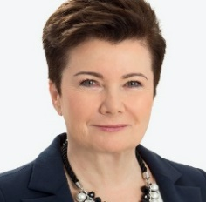



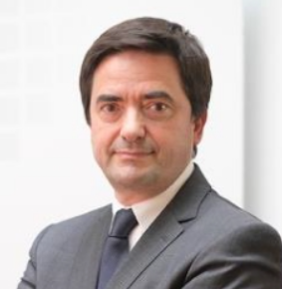


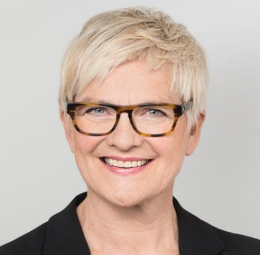
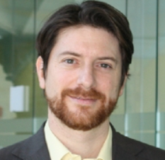
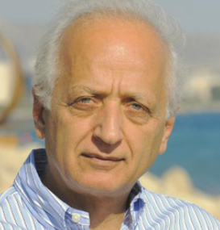

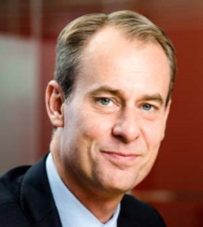

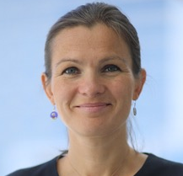

Mission Board for Climate Neutral and Smart Cities
Chair
Vice-Chair
Rapporteur
Hanna
GRONKIEWICZ-WALTZ
Allan LARSSON
Katrine Krogh ANDERSEN
Anna Lisa
BONI
Paulo
FERRAO
Emmanuel
FOREST
Romana JORDAN
Barbara
LENZ
Julio
LUMBRERAS
Chrysses
NICOLAIDES
Bertrand
PICCARD
Joakim
REITER
Martin
RUSS
Anne SULLING
Maria VASSILAKOU

Slide 44

Climate Neutral and Smart Cities
State of play I
Five Mission Board meetings in 2019- discussions concentrated on possible mission scoping
Support to the Board also by Foresight experts and workshop on scoping in November 2019

Slide 45
Climate Neutral and Smart Cities
State of play II
Holistic approach under discussion
R&I only a component of the Mission; synergies needed with other EU and SPC members programs and policies and funding sources
Working title of the Mission: « 100 Climate Neutral Cities by 2030 – by and for citizens » but discussion still ongoing on possible sectoral approach and delivery method

Slide 46
Climate Neutral and Smart Cities
State of play III
One possible delivery method that is under discussion is a « Climate City Contract »
Many actors should engage such as local governments (cities), regional and national authorities, civil society representatives and the EC:
  Ensure systemic transformation of a city towards climate neutrality;
  Involve citizens as co-designers and beneficiaries;
  Ensure commitments of all levels of policy makers, stakeholders and citizens;
  Promote innovation and better re-use of results of EU funded projects;
  Ensure financial and regulatory support from EU and national governments.

Slide 47
Climate Neutral and Smart Cities
State of play IV
Initial consultations with stakeholders have started e.g. R&I days, EuroCities, C40, Smart Cities Forum pending the finalisation of the scoping of the mission
Further consultations and citizens engagement activities will be launched beginning next year but are also dependent on the progress on the MFF and Horizon Europe negotiations

Slide 48

Mission on Climate Neutral Smart Cities
R&I Missions
Connect Europe closer to its citizens and key role of Cities
Cities will be central to deliver on Research and Innovation Policy. Commission’s proposal for Horizon Europe, Urban R&I Actions will be funded under several clusters within the Global Challenges and Industrial Competiveness pillar.
The Cluster on Climate, Energy and Mobility foresees an Intervention area on ‘Cities and Communities’ that aims to significantly increase the overall energy and resource efficiency, improve the climate-resilience and reduce the environmental footprint of the cities, promote safe mobility, improve cities' regenerative capacity, whilst enhancing the quality of life for the citizens.
Cross-disciplinary, cross-actor and cross-sector collaborations.
Notes:
Missions will be designed in the context of a strategic planning process [see section 'How?'].
Missions (Art. 7(3) of FP/RfP) shall
have a clear EU-added value and contribute to reaching Union priorities;
be bold and inspirational, and hence have wide societal or economic relevance;
indicate a clear direction and be targeted, measurable and time-bound;
be centered on ambitious but realistic research and innovation activities;
spark activity across disciplines, sectors and actors;
be open to multiple, bottom-up solutions.
'FET Flagships' supported under Horizon 2020 will continue to be supported under Horizon Europe. As they present substantial analogies with missions, other 'FET flagships', if any, will be supported under this Framework Programme as missions geared towards future and emerging technologies.

Slide 49
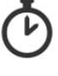
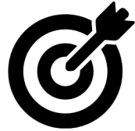
Timeline & Deliverables
January 2020 – C0onfirmation of proposed Missions
early 2020 - Meeting with Assembly & Member States
From Jan. 2020
Advisory role to the European Commission on the preparation of the calls on Missions for the first work programme for Horizon Europe;
Outreach activities to engage Member States and general public
By end of 2020 - Report with Mission Board advice, overall recommendations & pending issues to be taken forward
2020

Slide 51





Lessons Learned Key Novelties from Horizon 2020 Interim Evaluation in Horizon Europe
Support breakthrough innovation
European Innovation Council
Create more impact through mission-orientation and citizens' involvement
R&I Missions
Extended association possibilities
Strengthen international cooperation
Reinforce openness
Open science policy
Rationalise the funding landscape
New approach to Partnerships
Notes:
The H2020 interim evaluation identfied five main areas for improvement, including the need to rationalise the funding landscape;
As one important contribution to the rationalisation of the funding landscape, Horizon Europe presents a new approach to partnerships

Slide 52

New approach to partnerships: why?
Impact Assessment annex 8-5
Need to rationalise the European R&I partnerships landscape
Need to improve the openness and transparency of R&I partnerships
Need to link the R&I partnerships to future EU R&I missions and/or strategic priorities
Notes:
Need to rationalise the European R&I partnerships landscape
close to 100 different R&I partnerships in Horizon 2020 with multiple structures and rationales.
Risk of a static system that gives preference to the continuation of existing partnerships, instead of creating opportunities for new ones of greater relevance.
Need to improve the openness and transparency to launch future European R&I partnerships
Smaller actors and R&D less-intensive countries and regions often do not have necessary (human) resources to participate on equal terms.
barrier for a more optimal and inclusive participation of all types of stakeholders are hampering the diffusion of knowledge.
Need to link European R&I partnerships to future EU R&I missions and strategic priorities
Limited coherence between R&I partnerships within certain thematic fields (including obvious thematic overlaps) and between the R&I partnerships and FP priorities.

Slide 53
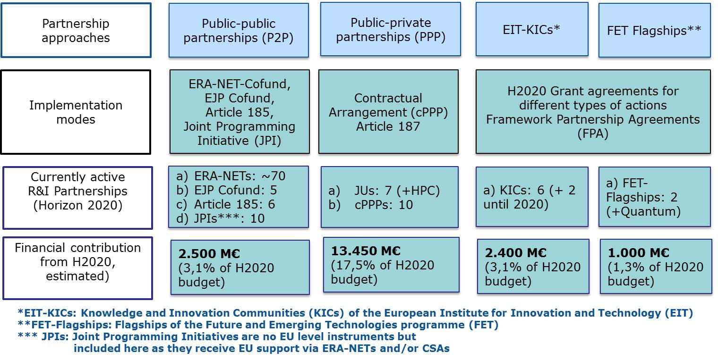
New approach to partnerships: why?
Impact Assessment annex 8-5 – current partnership landscape
Notes:
Figure stems from the Horizon Europe Impact Assessment
It includes all partnership approaches that has been identified by Council in December 2017 (not all consider FET-Flagships and EIT/KICs as partnerships)
JPIs are included as they usually are supported by H2020 via CSAs and ERA-NET Co-funds;
The forthcoming EURO HPC (JU) and the planned two additional KICs are included in brackets as well;
Financial contributions are estimated

Slide 54
European Partnerships: what is new?
Only support partnerships if there is evidence that they are more effectively achieving policy objectives than Horizon Europe alone
Fewer partnerships with higher impacts
Common and coherent framework of criteria along the life cycle of partnerships, across all pillars, even across programmes and other regulations (e.g. EIT, DEP, space)
Unified umbrella branding to improve visibility
Increase openness and encourage a broader set of actors to participate
Improve coherence between partnerships and Horizon Europe, also the missions
Time limited with conditions for phasing-out the Programme funding
Notes:
Horizon Europe will limit the use of partnerships to areas where they will more effectively achieve objectives of the programme;
This includes i.a. that partnerships should engage into a broader set of joint actions beyond joint calls, including those related to market, regulatory or policy uptake;
Partnerships contribute very visible to the further realisation of the ERA – that should be 'showcased' more in the future;
Partnerships have the potential to play an important role for 'sharing excellence' amd hence contributing to a better openness of the R&I ecosystems in Europe – we want to better use this potential.

Slide 55
Portfolio of candidates for
European Partnerships
HEALTH
EU-Africa Global Health
Innovative Health Initiative
Chemicals Risk Assessment
Fostering an ERA for Health research
Large-scale innovation and transformation of health systems in a digital and ageing society
Pre-clinical / clinical health research
Personalised Medicine
Rare Diseases
DIGITAL, INDUSTRY AND SPACE
High Performance Computing
Key Digital Technologies
Smart Networks and Services
AI, data and robotics
Photonics Europe
Clean Steel - Low Carbon Steelmaking
European Metrology
Made in Europe
Carbon Neutral and Circular Industry
Global competitive space systems
PILLAR III AND CROSS-PILLAR
EIT Climate KIC
EIT Health
EIT Manufacturing
EIT Food
EIT InnoEnergy
EIT Manufacturing
EIT Raw Materials
EIT Digital
EIT Urban Mobility
Innovative SMEs
European Open Science Could (EOSC)
FOOD, BIOECONOMY, NATURAL RESOURCES, AGRICULTURE AND ENVIRONMENT
Accelerating farming systems transition
Animal health: Fighting infectious diseases
Environmental Observations for a sustainable EU agriculture
Rescuing biodiversity to safeguard life on Earth
A climate neutral, sustainable and productive Blue Economy
Safe and Sustainable Food System for
People, Planet & Climate
Circular bio-based Europe
Water4All: Water security for the planet
CLIMATE, ENERGY AND MOBILITY
Transforming Europe's rail system
Integrated Air Traffic Management
Clean Aviation
Clean Hydrogen
Built environment and construction
Towards zero-emission road transport
Mobility and Safety for Automated Road Transport
Batteries
Clean Energy Transition

Slide 56
Programme co-fund action
  “Based on a joint programme agreed by partners, an action to provide multi-annual co-funding to a programme of activities established and/or implemented by entities managing and/or funding research and innovation programmes, other than Union funding bodies
  Commitment of partners for financial and in-kind contributions & financial contribution by Horizon Europe
  Programme of activities may support networking and coordination, research, innovation, pilot actions, and innovation and market deployment actions, training and mobility actions, awareness raising and communication, dissemination and exploitation, …
Notes:
These provisions refer to the proposal for the regulation establishing Horizon Europe and its impact assessment;
Definition 3 refers to the overall European Partnership approach but not to the different forms of European Partnerships (typology);
A dedicated article is devoted to European Partnerships with a dedicated annex (Annex III) on the life-cycle based criteria – overall basis is a dedicated chapter in the ex ante impact assessment;
The Annex II describes the types of actions supported by Horizon Europe – it should be noted that 'programme co-fund actions' will not exclusively used by European Partnerships but also by other parts of the programme, incl. MCSA and actions under the open innovation pillar;

Slide 57
Objectives
Promote EU-wide collaboration, mobilise resources, investments and relevant actors in R&I to support European cities in their climate and sustainability transition in line with their EU and international commitments (e.g. Green Deal, Paris Agreement, the UN SDGs, the Urban Agenda to the EU, the New Urban Habitat Agenda agreed in Quito)
Promote alignment of EU, national and regional R&I agendas and rolling out of joint activities (joint calls and beyond) for optimal use of resources, synergies and enhanced impact
Provide new knowledge, evidence and promote development, upscaling and taking up of innovative solutions, new governance, business and financing models to accelerate transition towards sustainability and climate neutrality

Slide 58
Expected impact
Enhanced capacity among cities, stakeholders, businesses and societal actors to design and implement timely and cost-effective transformative measures for climate and sustainability transition;
Enable Europe to become the world’s first climate-neutral continent by 2050 (Green Deal) and fulfil its commitments vis-à-vis EU and international policy frameworks (e.g. Green Deal, Paris Agreement, the UN SDGs, the Urban Agenda to the EU, the New Urban Habitat Agenda agreed in Quito);
Establish sustainable Europe-wide and international city networks, communities of urban practitioners and long-term sustainable knowledge and evidence repositories for sharing experiences, peer-learning and creation of new markets
Synergies with missions and other relevant partnerships for enhanced impact and better use of investments

Slide 59
New Cities partnership
Proposal to be prepared through an iterative and co-design process between consortium and Commission process for openness and full accounting of EU policy needs and relevant EU initiatives;
Consortium to be open, transparent and inclusive regarding identification of vision, elaboration of SRIA and involvement of partners;
Ensure full geographical coverage of the EU, including associated States, for alignment of R&I programmes, priorities, activities and investments

Slide 60
New Cities partnership
Target wide diversity of European cities;
Take stock of relevant ongoing and past EU and nationally-funded R&I activities on urban transitions;
Establish close links and synergies with other relevant potential partnerships and missions on ‘Climate-neutral and smart cities’ and ‘Adapting to climate change, including societal transformation’;
Provide an as accurate estimate of R&I investments to achieve specific objectives to allow proper Horizon Europe planning.

Slide 61
Thank you for your attention!
OBRIGADA!
marie.yeroyanni@ec.europa.eu

